Slide 1
Maker Camp Arduino
Nancy Rochford, Becky Oberhauser, Ryan Brock

Slide 2
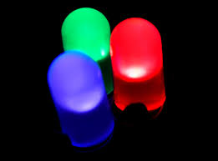
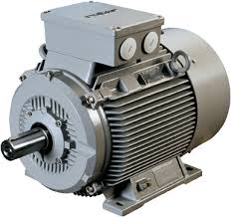
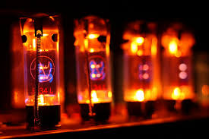
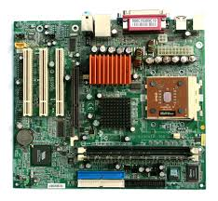
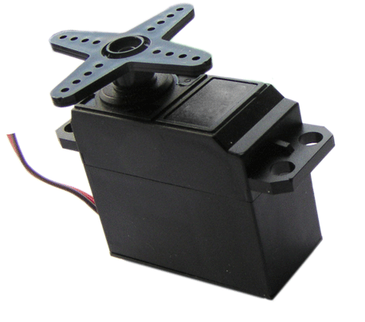
Hardware

Slide 3
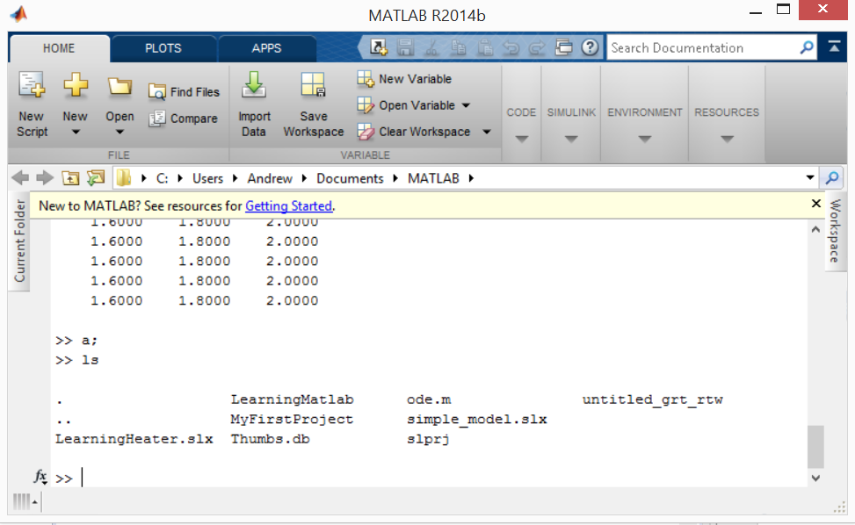
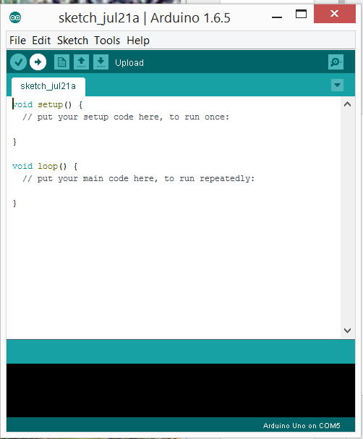
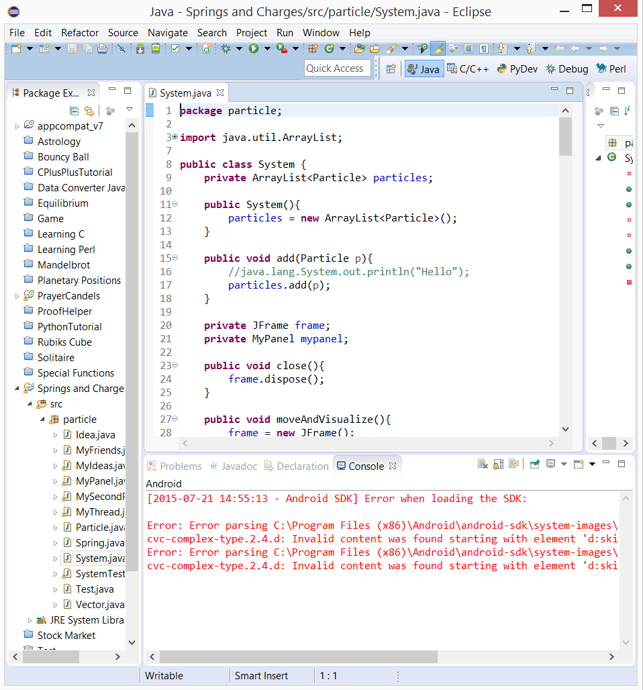
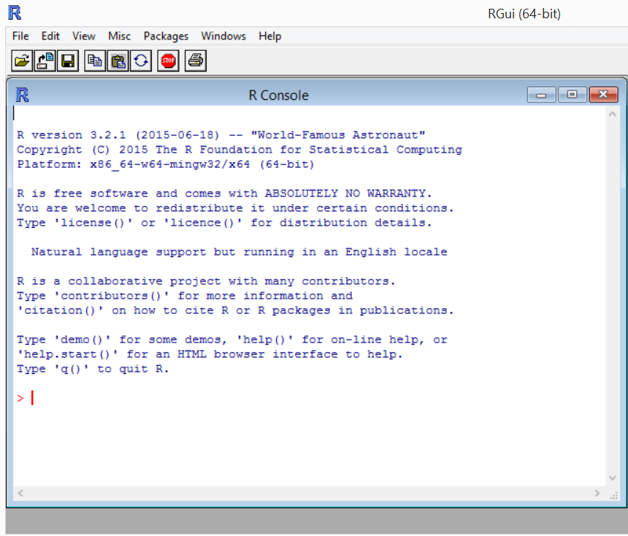
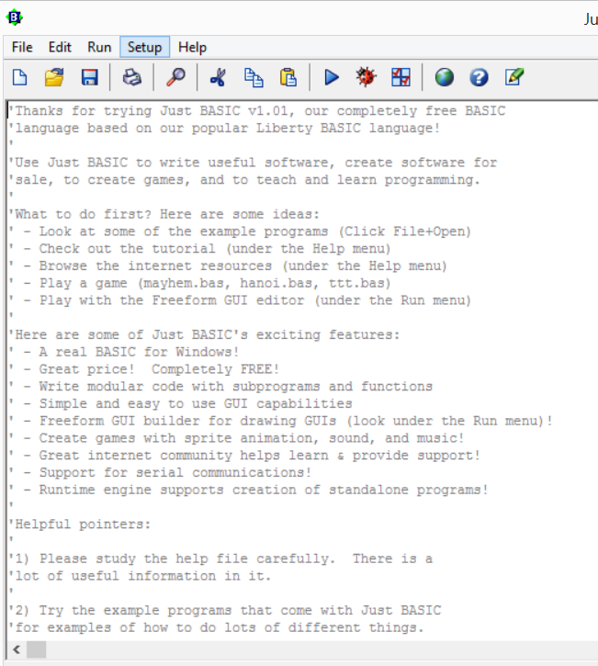
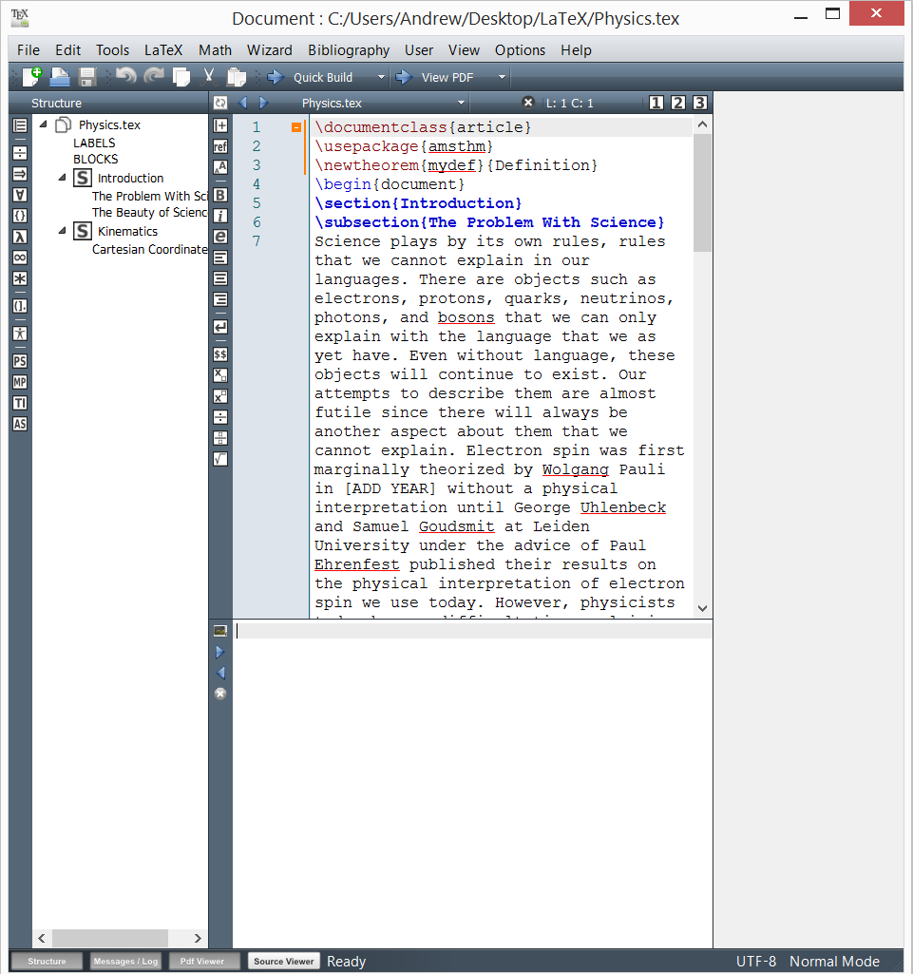
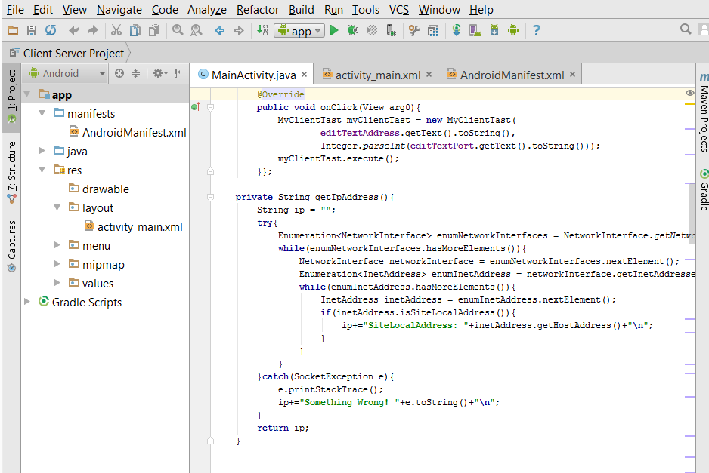
Software

Slide 4

The Arduino Uno

Slide 5
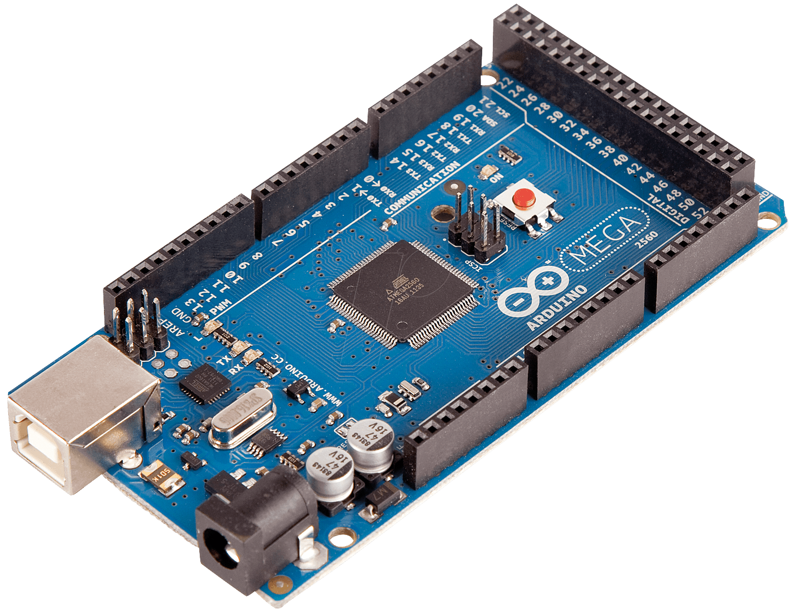
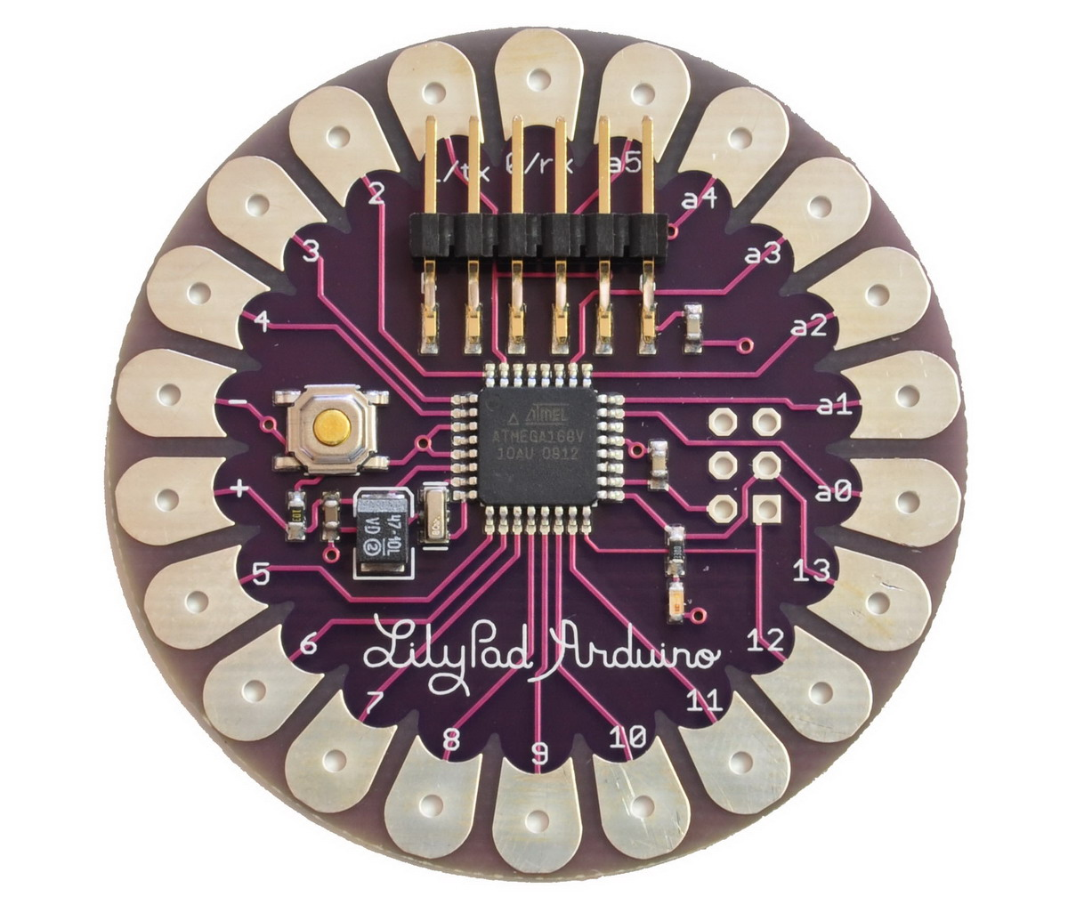
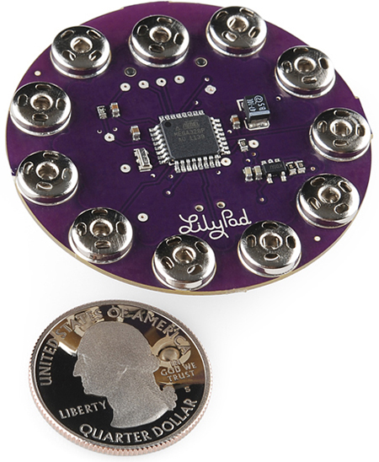
The Arduino Family

Slide 6
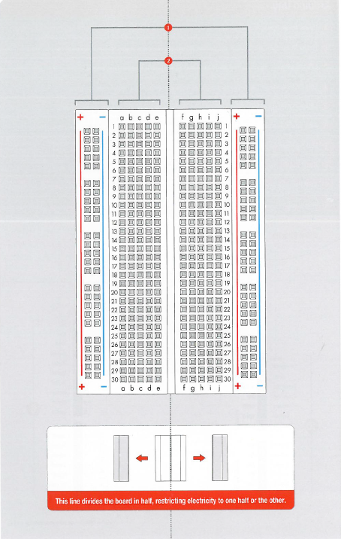

Slide 7
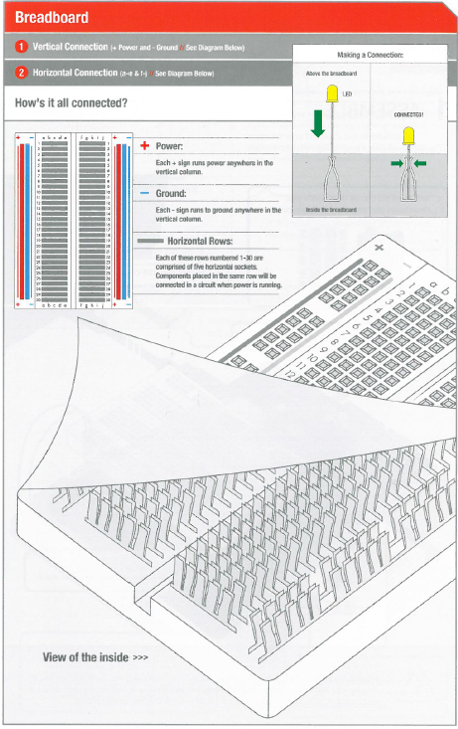

Slide 8
Breadboard
Where is C:19?

Slide 9

Just Like Battleship

Slide 10
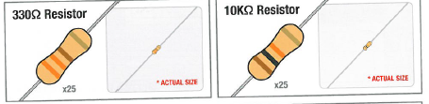
Be careful to use the correct resistor!

Slide 11
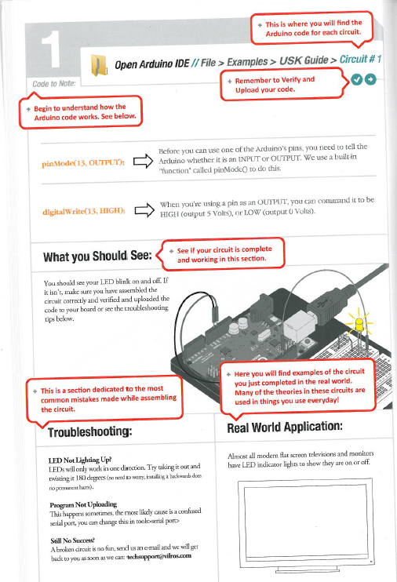
Guide sections have lots of help

Slide 12
Begin Circuit 1!
20 Minutes

Slide 13
Alterations
Turn the LED around so the longer pin is in C2 instead of C3 (then switch it back)
Alter the time the LED is on and off so that is on for 3 seconds and off for ½ second
Change the pin from pin 13 to pin 2
Use 2 330 Ω resistors in place of the 10K Ω resistor
Replace the 2 330 Ω resistors with a single 10K Ω resistor
Alter the program so that the LED blinks on and off for 1 second, then 2 seconds, then 3 seconds, then 4, then 5, then repeats starting with 1 second

Slide 14
Circuit 1 lessons
A program is called a “sketch”
A sketch:
contains setup() area
contains loop() area
uses “/* */” or “//” for comments
uses “;” to separate instructions
Commands used:
pinMode(13, OUTPUT);
digitalWrite(13, HIGH);
delay(1000);

Slide 15
Circuit 1 lessons
Higher Resistance reduces the LED brightness
The ‘D’ in LED stands for diode which means current can only travel in one direction

Slide 16
Circuit 1 questions
Why do we need the resistors in series with the LED?
What happens each time we add a new one in series or swap it with a much higher resistance?
What would happen if we moved the code from loop() and put it all into setup()?
Did anyone use a loop to modify the program for the last alteration?

Slide 17
Why is one lead longer?

Slide 18
Begin Circuit 2!
15 Minutes

Slide 19
Measurement
Use the multi-meter to read the voltage and resistance across the potentiometer

Slide 20
Circuit 2 lessons
Arduino has digital and analog pins
Commands used:
analogRead(sensorPin);
Variable resistance LED brightness

Slide 21
Circuit 2 questions
Can you describe the difference between the digital and analog pins?
What else can we do with the potentiometer?

Slide 22
Voltage Division

Slide 23
Voltage Division
Assume
Vin = 5V
R1 = 100 Ohms
R2 Range is 0 to 100 Ohms

Slide 24
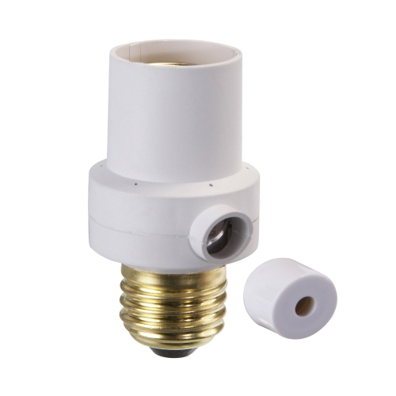

Uses of Potentiometers and Variable Resistance Components

Slide 25
Begin Circuit 3!
20 Minutes

Slide 26
Alterations
Drive all three pins and then use different resistors to adjust the brightness and/or color of the LED
Use a potentiometer to adjust the brightness
Use a potentiometer to adjust the color

Slide 27
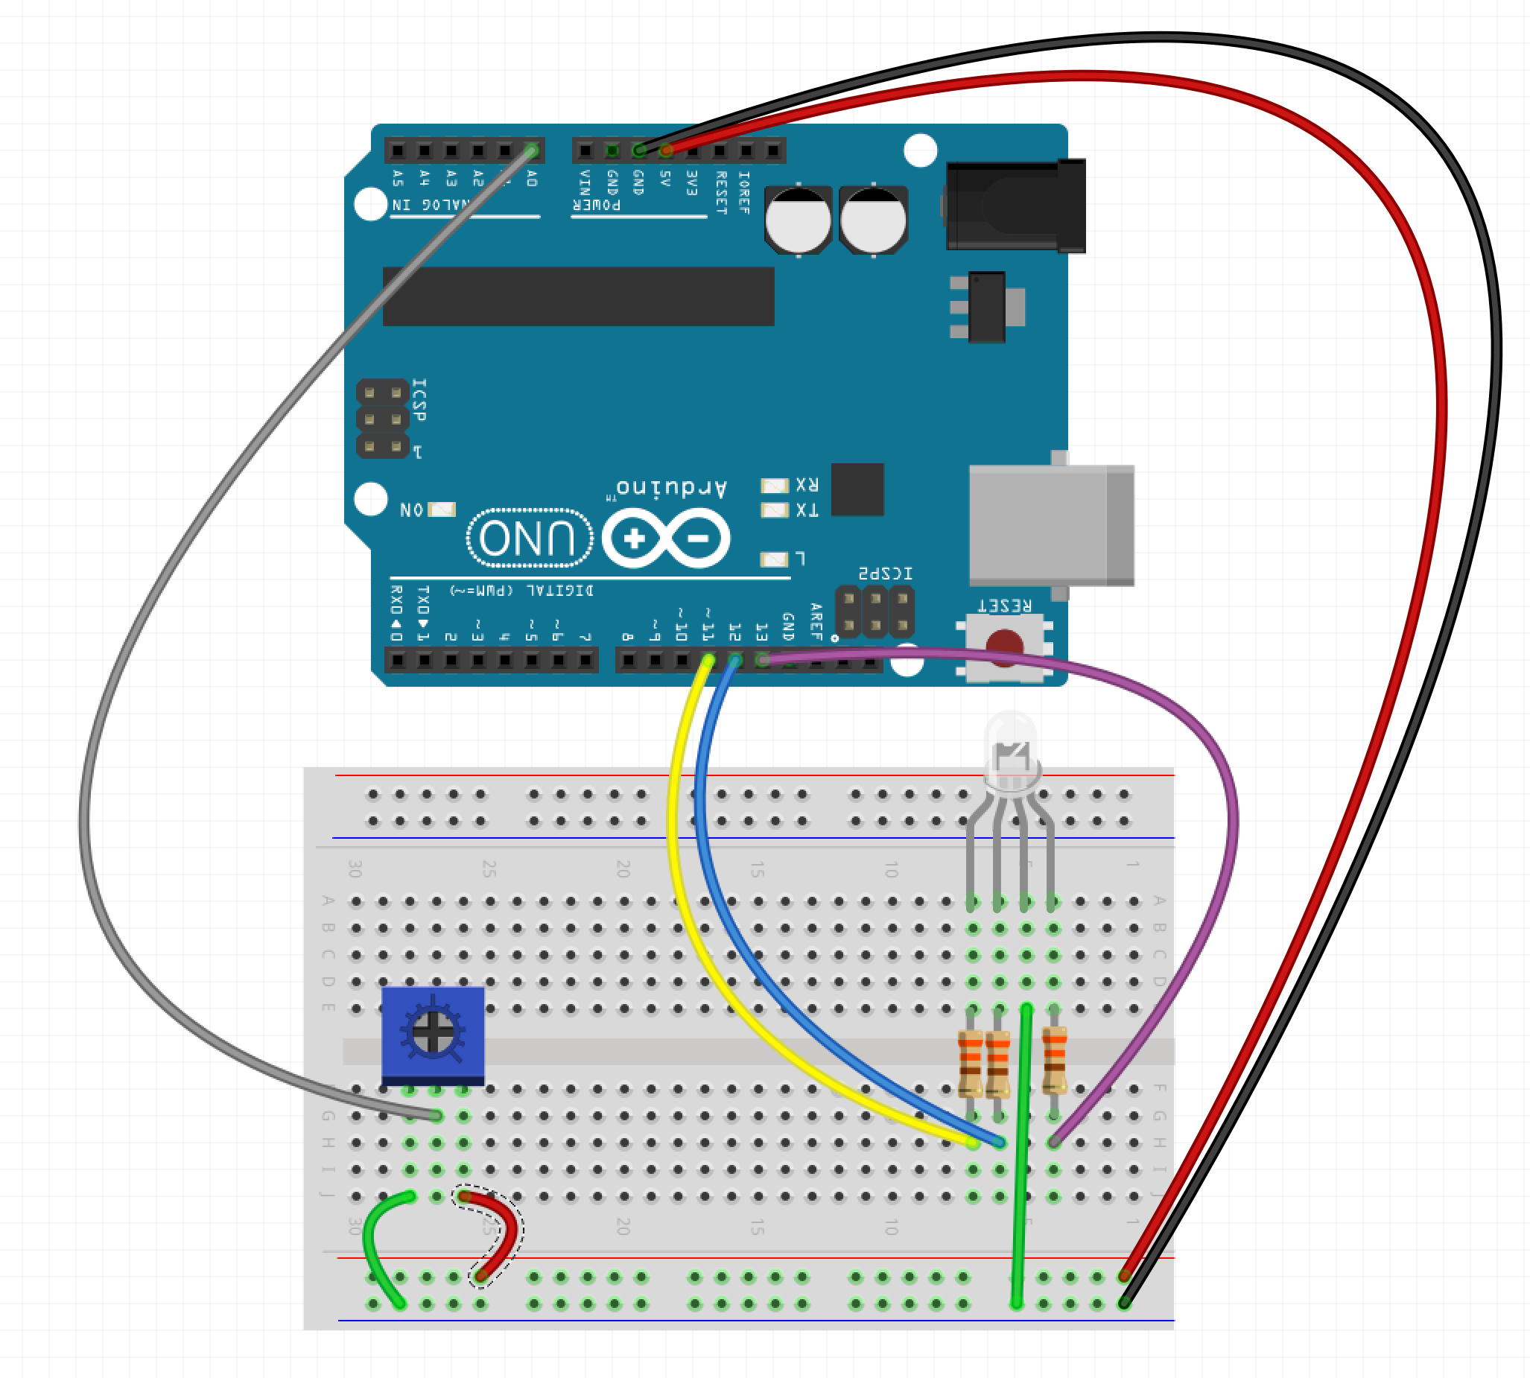
Potentiometer Configuration

Slide 28
Circuit 3 lessons
All visible color can be generated with three colors, red, green, and blue (RGB)
The colors can be generated by adjusting the brightness of each color
The Arduino can adjust the brightness by using a PWM to drive the pins and simulate varying voltages between 0 and 5V

Slide 29
Circuit 3 questions
What is the duty cycle of a PWM?
Can you explain the difference between duty cycle and frequency?
How do you make the color purple with an RGB LED?

Slide 30
PWM

Slide 31
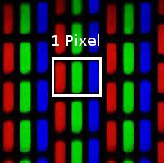

Monitor/TV/Display Pixels

Slide 32
Begin Circuit 9!
15 Minutes

Slide 33
Alterations
Play Mary Had a Little Lamb
EDCDEEE DDD EGG EDCDEEEEDDEDC
Make the speaker sound like a police siren
Add a potentiometer to adjust the frequency

Slide 34
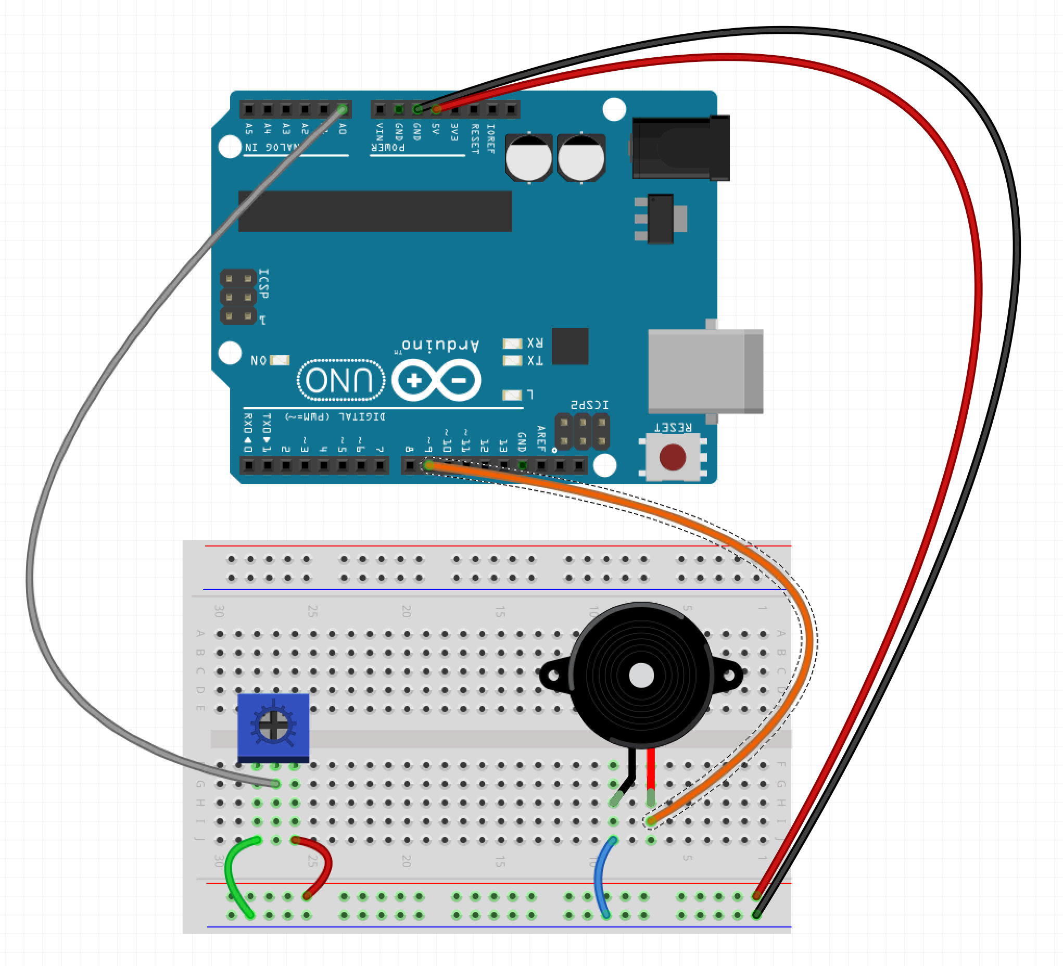
Potentiometer Configuration

Slide 35
Circuit 9 lessons
The piezo has the ability to play different frequencies
The Arduino can generate frequencies from 31 to 65535
The piezo in the kit can generate frequencies up to 2048 Hz
The arduino can generate the frequencies using:
tone(pin, frequency)

Slide 36
Circuit 9 questions
How does a piezo work?
What do you think the Arduino is doing in order to generate the various frequencies?

Slide 37
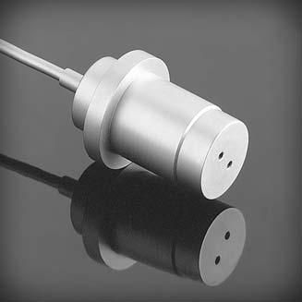
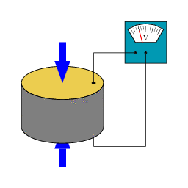
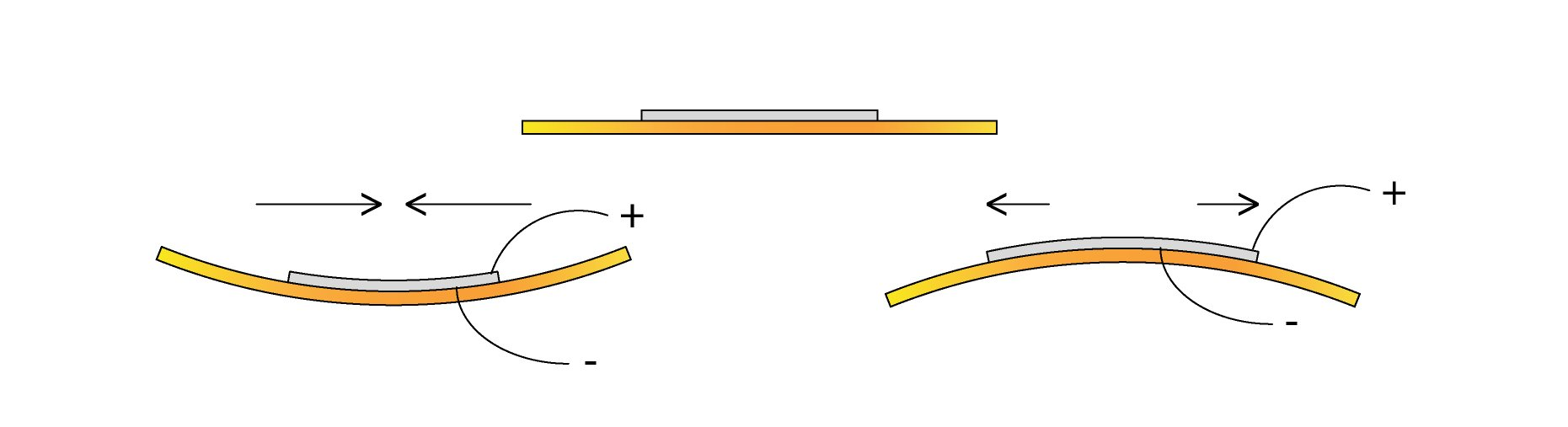
Piezoelectric Components

Slide 38
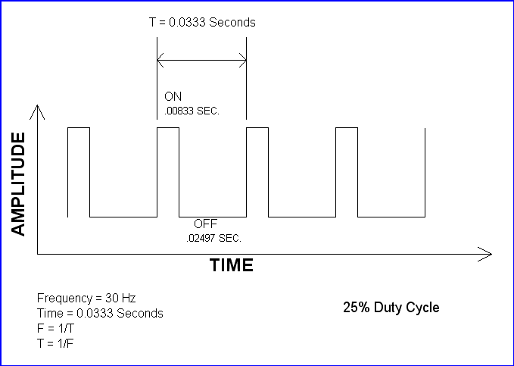
Frequency or Duty Cycle?

Slide 39
Begin Circuit 10!
15 Minutes

Slide 40
Alterations
Add a potentiometer rather than using the Serial input

Slide 41
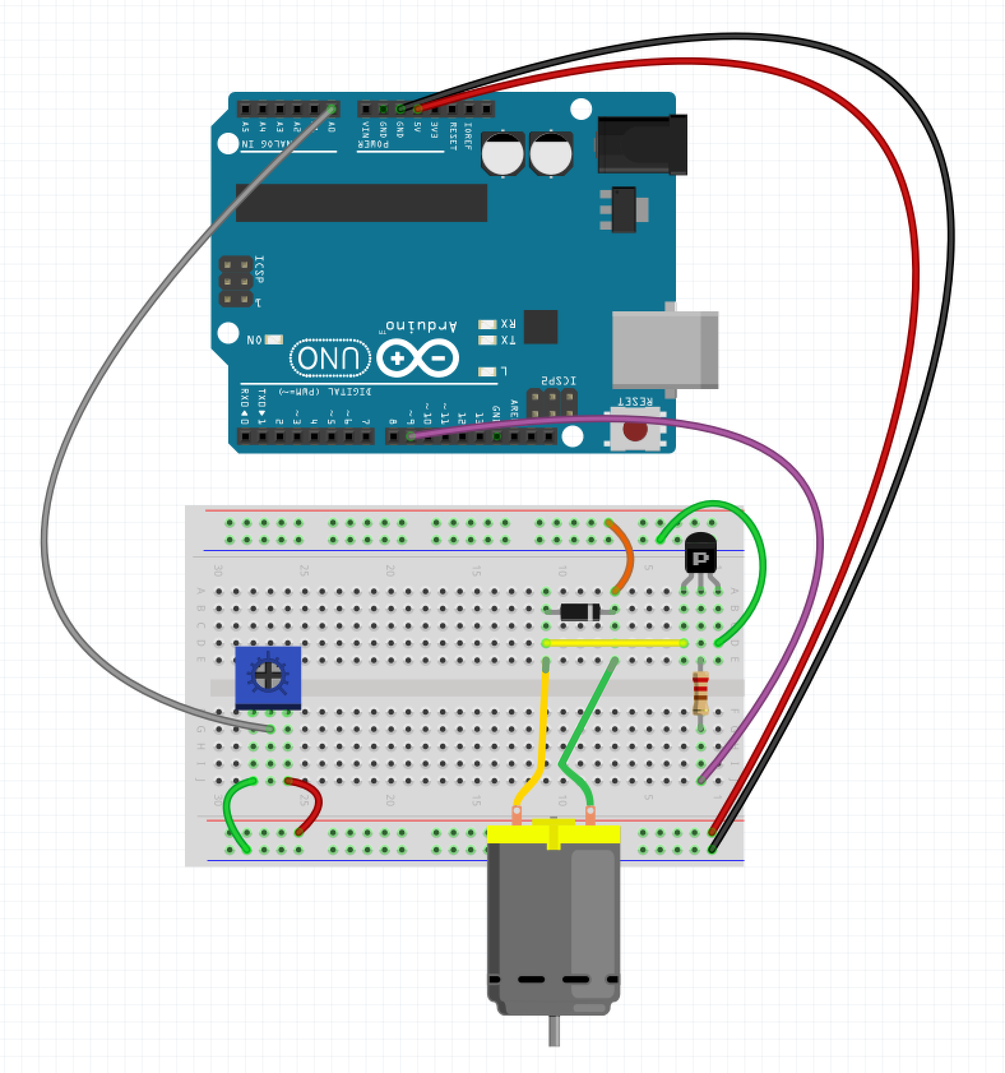
Potentiometer Configuration

Slide 42
Circuit 10 lessons
Transistors allow the Arduino to drive a higher current device like a motor
Transistors act like a digital switch
We can control the DC motor using the Arduino’s PWM

Slide 43
Circuit 10 questions
What is a diode?
Why is it used in the circuit?
How might we change the motor’s direction?

Slide 44
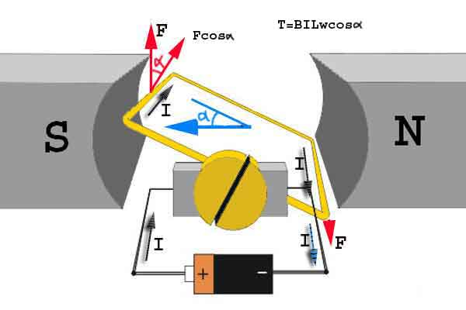
DC Motors

Slide 45
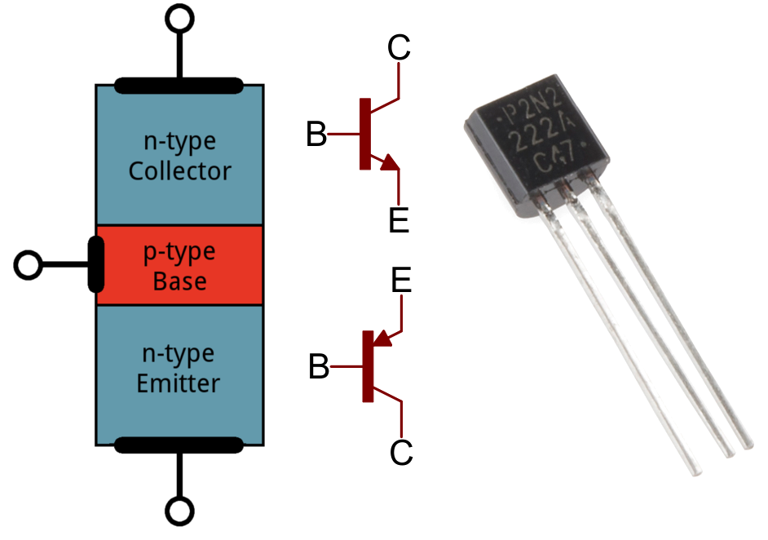
Transistors

Slide 46
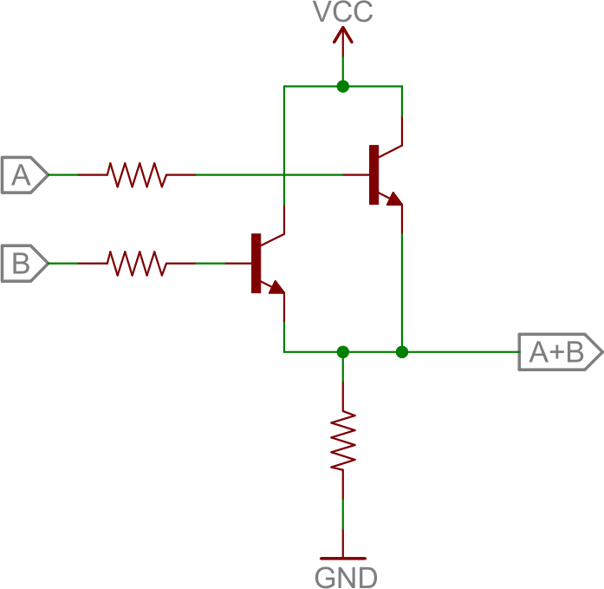
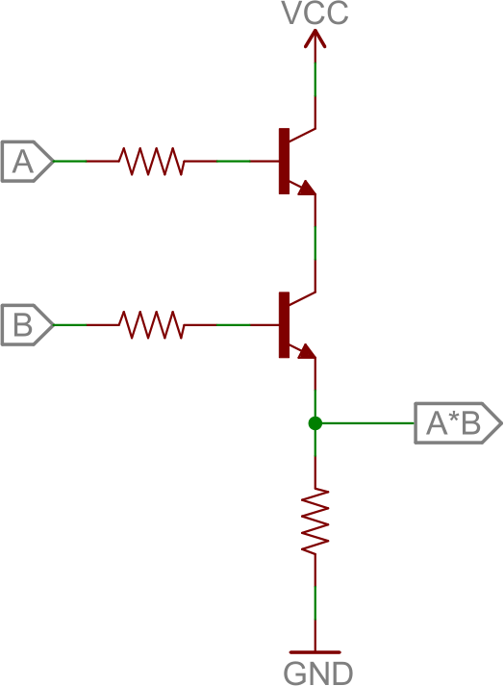
Digital Logic
OR gate
AND gate

Slide 47
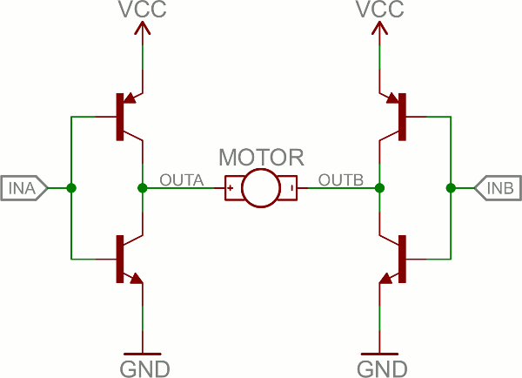
H-Bridge

Slide 48
Code Alterations
https://github.com/borq79/Cary-Area-Public-Library-Classes/tree/master/courses/arduino_maker_camp_day

